Slide 1
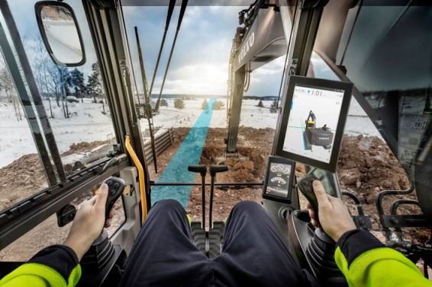
CoPilot driver statistics project
11/14/2016
Team members:
Vladimir Djukanovic
Leslie Dahlberg
Léa Brunschwig
Eric Engtorp
Fredrik Frenning
Pooria Ghavamian
Hamza Sabljakovic

Slide 2
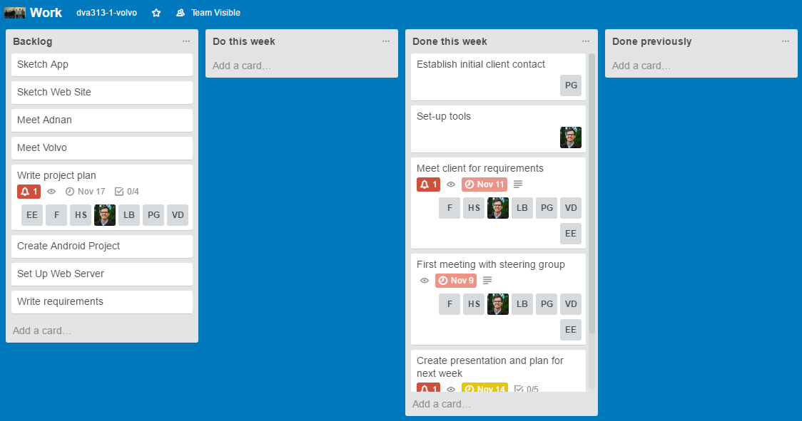
Trello – last week

Slide 3
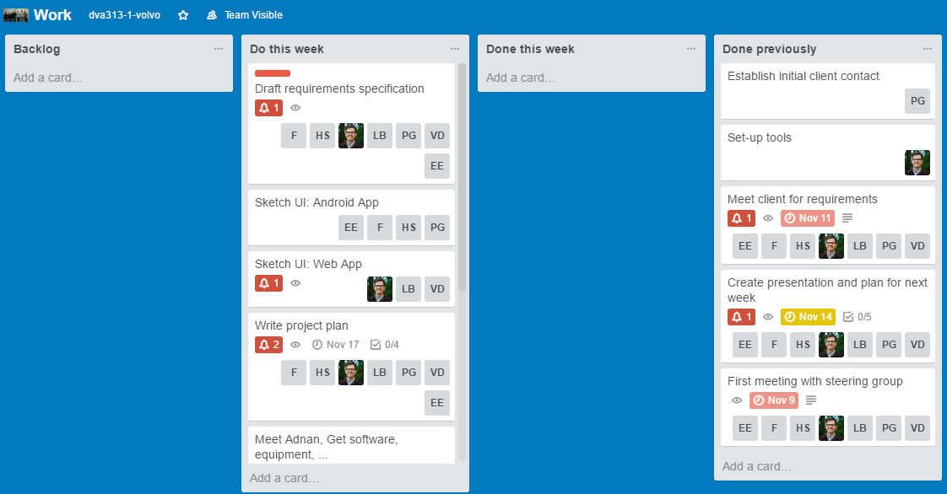
Trello – following week

Slide 4
Plan for following week
Requirements (Everyone)
Sketch UI
Android (Hamza, Eric, Fredrik, Pooria)
Web portal (Vladimir, Lea, Leslie)
Project plan report (Everyone)
Meeting with Adnan (Everyone)
Plan meeting with Volvo – discuss UI (Pooria)
Create presentation for project plan and requirements meeting (Everyone)

Slide 5
Obstacles
Getting access to the Volvo lab

Slide 6
Activities
Name | Last week | Total
Vladimir Djukanovic | 15 | 15
Hamza Sabljakovic | 15 | 15
Léa Brunschwig | 15 | 15
Eric Engtorp | 15 | 15
Fredrik Frenning | 15 | 15
Pooria Ghavamian | 15 | 15
Leslie Dahlberg | 15 | 15

